Slide 1
Chapter 9 Communications and Networks

Slide 2
Chapter 9 Objectives
Discuss the components required for successful communications
Explain the purpose of communications software
Identify various sending and receiving devices
Describe various types of lines for communications over the telephone network
Describe uses of computer communications
Describe commonly used communications devices
List advantages of using a network
Discuss different ways to set up a home network
Differentiate among client/server, peer-to-peer, and P2P networks
Identify various physical and wireless transmission media
Describe the various network communications standards
Next

Slide 3
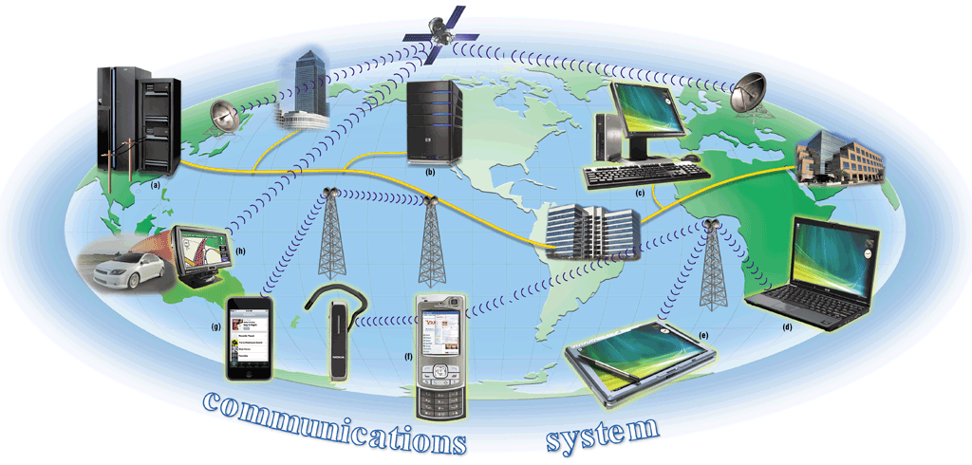
Communications
What are computer communications?
Process in which two or more computers or devices transfer data, instructions, and information
p. 460 – 461 Fig. 9-1
Next

Slide 4
Communications
What is needed for successful communications?
Sending device — initiates instruction to transmit data, instructions, or information
Communications device — connects the sending device to the communications channel
Communications channel — media on which data, instructions, or information travel
Communications device — connects the communications channel to the receiving device
Receiving device — accepts transmission of data, instructions, or information
p. 460 - 461
Next

Slide 5
Uses of Computer Communications
What are some uses of communications technology?
Internet
Web
E-Mail
Instant Messaging
Chat Rooms
Newsgroups
Blogs
Wikis
RSS
VoIP
FTP
Web Folders
Video Conferencing
Fax Machine or Computer Fax/Modem
p. 462
Next

Slide 6

Uses of Computer Communications
Video: Trillian
CLICK TO START
Next

Slide 7
Uses of Computer Communications
What are wireless messaging services?
Text messaging allows users to send and receive short text messages on a phone or other mobile device
Wireless instant messaging allows wireless mobile devices to exchange messages
Picture/video messaging allows users to send graphics, pictures, video clips, sound files, and short text messages
Click to view Web Link, click Chapter 9, Click Web Link from left navigation, then click Video Messaging below Chapter 9
p. 463 - 464
Next

Slide 8
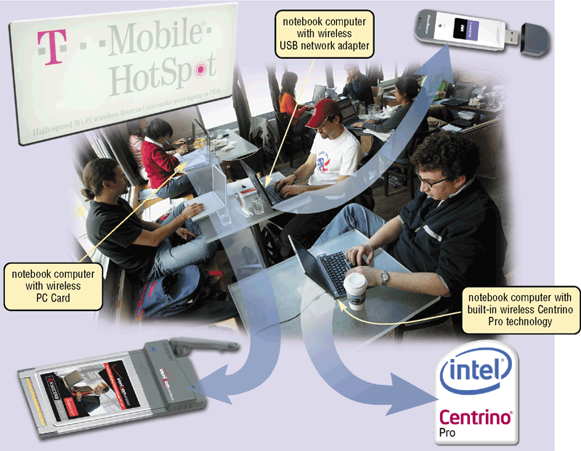
Uses of Computer Communications
What are wireless Internet access points and cybercafés?
Wireless Internet access point allows wireless connection to Internet in public location
3G and 4G networks
Cybercafé is a coffee house that provides computers with Internet access
p. 464-465 Fig. 9-4
Next

Slide 9
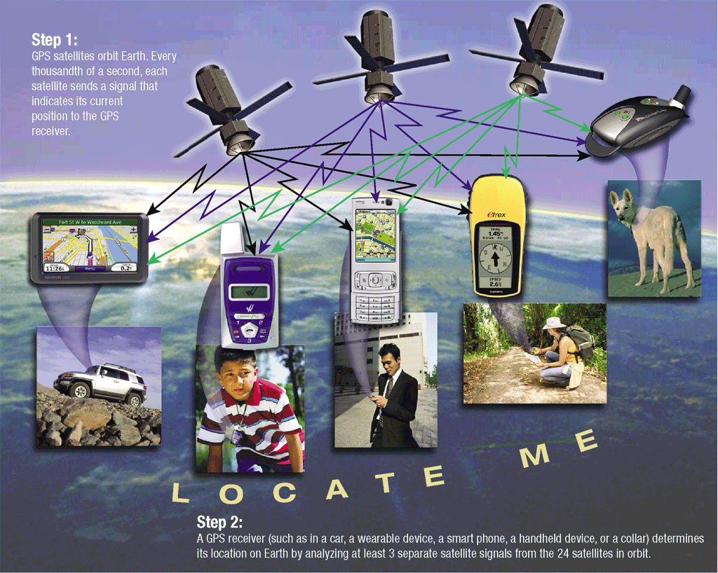
Uses of Computer Communications
What is a global positioning system (GPS)?
Step 1. GPS satellites orbit Earth. Every thousandth of a second, each satellite sends a signal that indicates its current position to the GPS receiver.
Step 2. A GPS receiver (such as in a car, a wearable device, a smart phone, a handheld device, or a collar) determines its location on Earth by analyzing at least 3 separate satellite signals from the 24 satellites in orbit.
Click to view Web Link, click Chapter 9, Click Web Link from left navigation, then click GPS below Chapter 9
p. 466 Fig. 9-6
Next

Slide 10
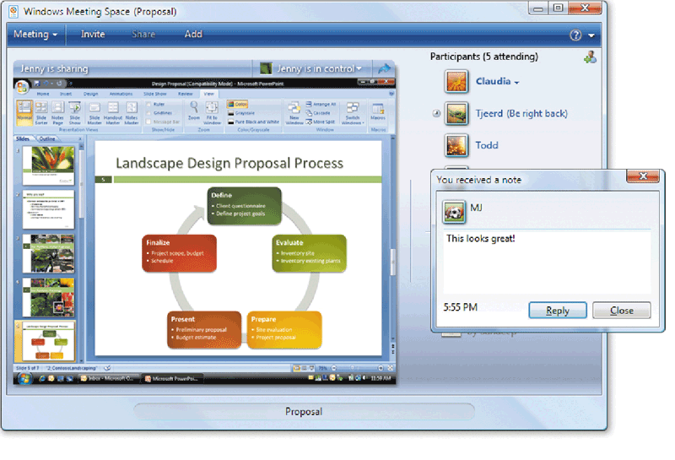
Uses of Computer Communications
What are collaboration and groupware?
Collaboration is working with other users connected to a server
Web conference
Groupware is software that allows people work together and share information
Click to view Web Link, click Chapter 9, Click Web Link from left navigation, then click Web Conferences below Chapter 9
p. 467 Fig. 9-7
Next

Slide 11
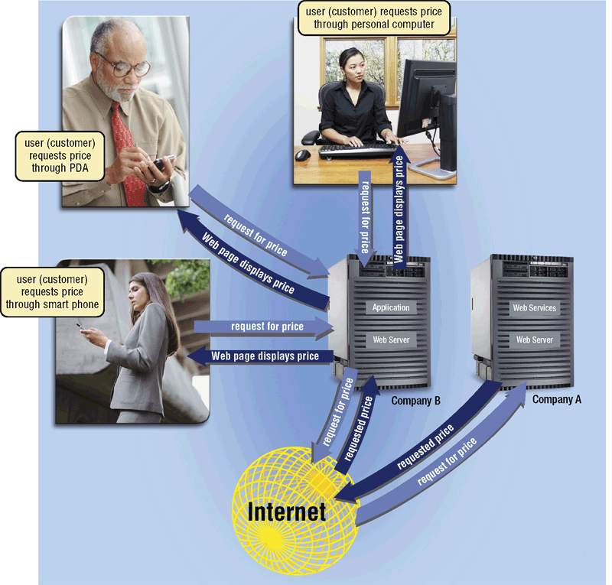
Uses of Computer Communications
What are voice mail and web services?
Voice mail is voice message converted to digital form
Web services describe standardized software that enables programmers to create applications that communicate with other remote computers over the Internet or on an internal business network
p. 468 Fig. 9-8
Next

Slide 12
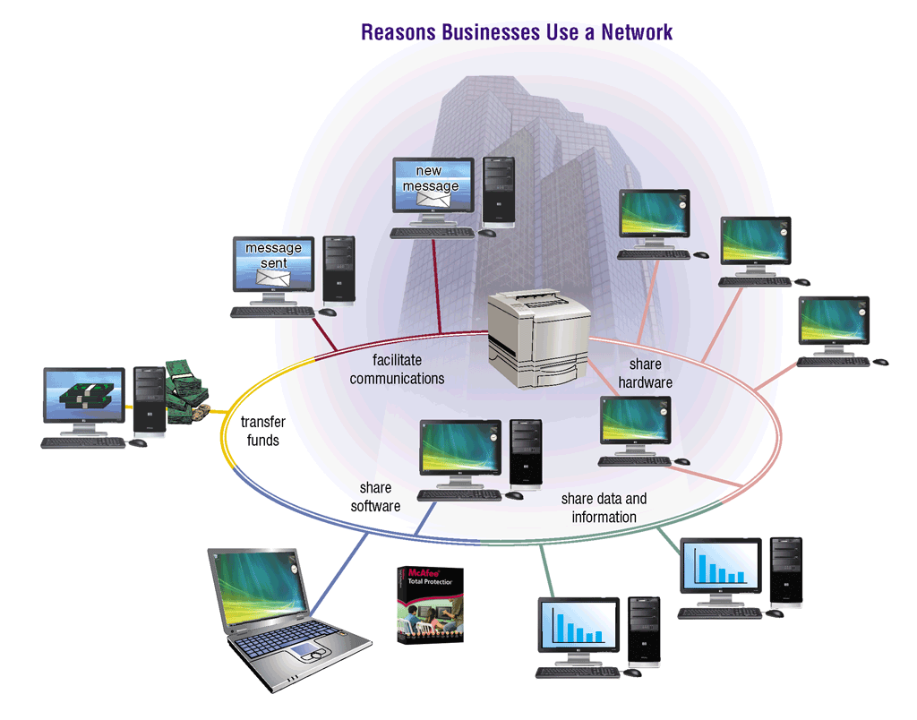
Networks
What is a network?
Collection of computers and devices connected via communications devices and transmission media
p. 469 Fig. 9-9
Next

Slide 13
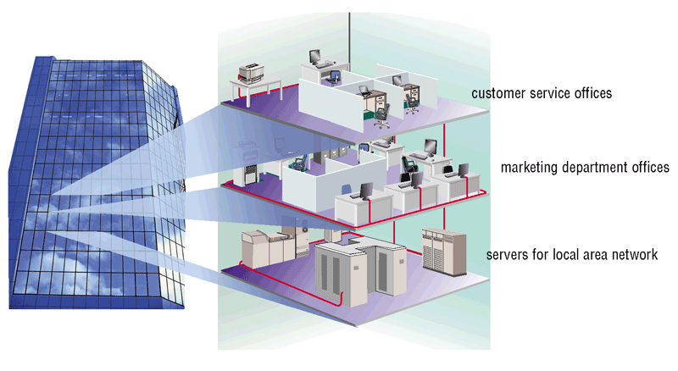
Networks
What is a local area network (LAN) and a metropolitan area network (MAN)?
A LAN is a network in limited geographical area such as home or office building
Wireless LAN (WLAN)
Metropolitan area network (MAN) connects LANs in city or town
p. 471 – 472 Fig. 9-10
Next

Slide 14
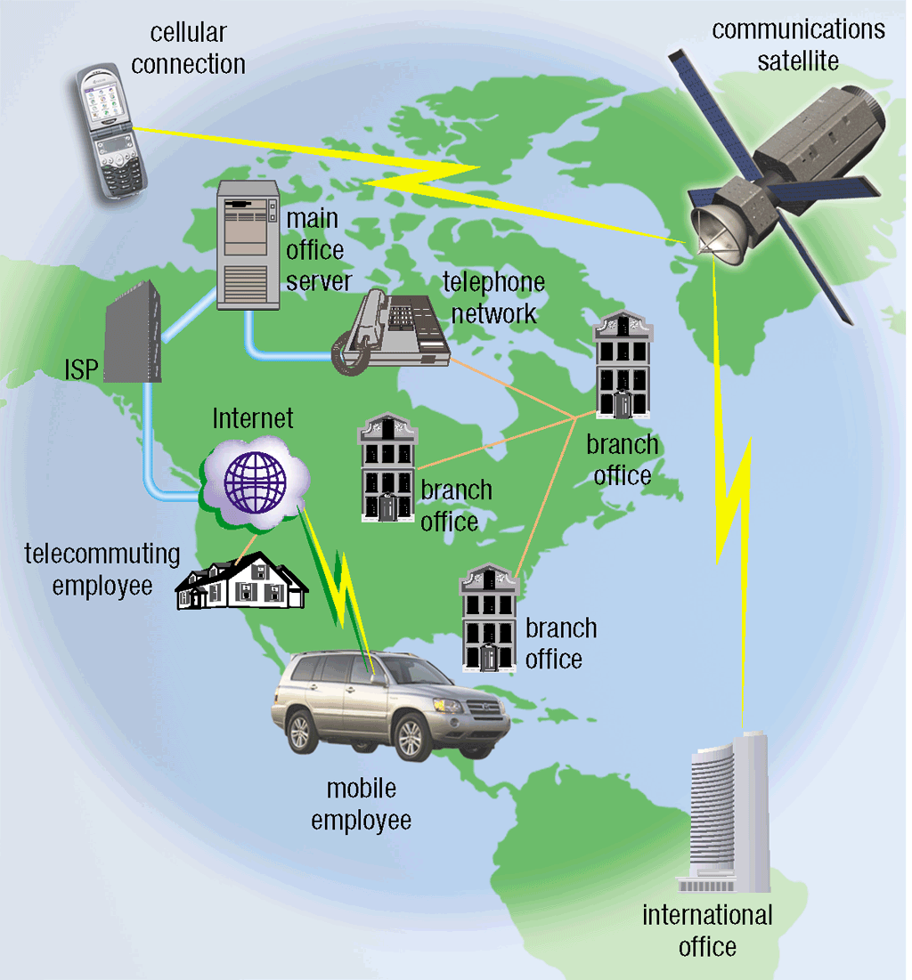
Networks
What is a wide area network (WAN)?
Network that covers large geographic area using many types of media
Internet is world’s largest WAN
p. 472 Fig. 9-12
Next

Slide 15
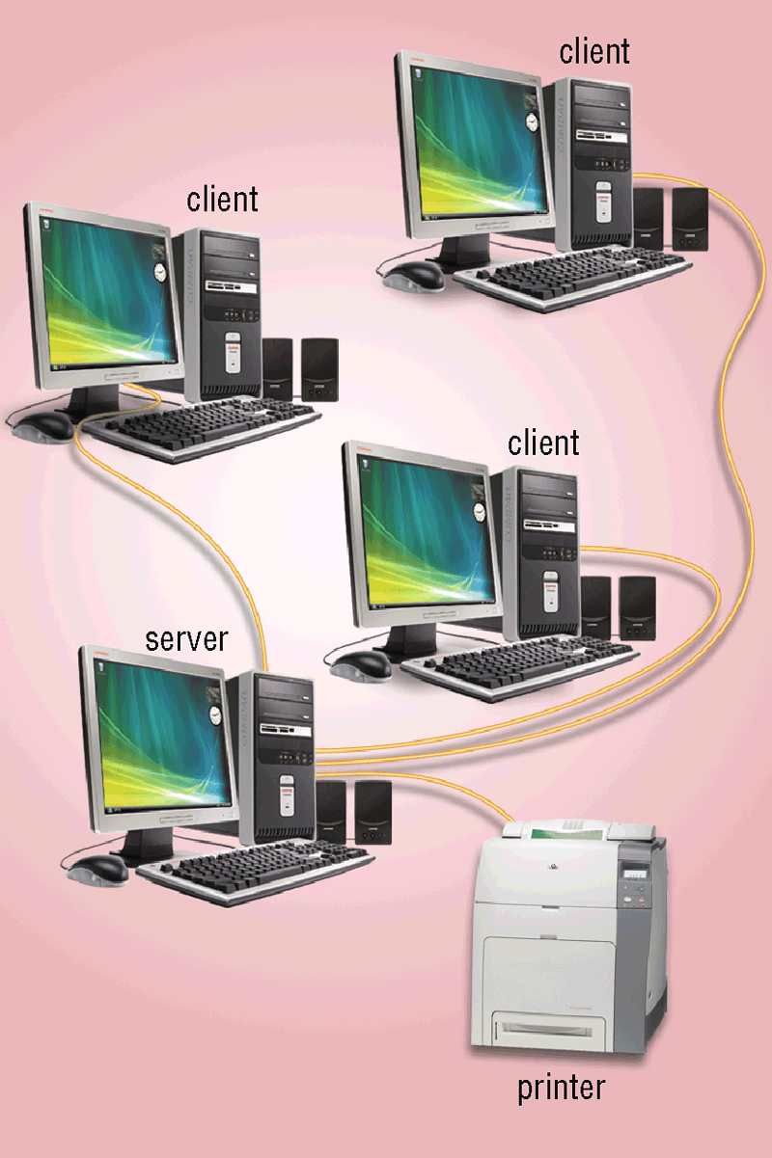
Networks
What is a client/server network?
One or more computers act as server and other computers, or clients, access server
p. 472 Fig. 9-13
Next

Slide 16
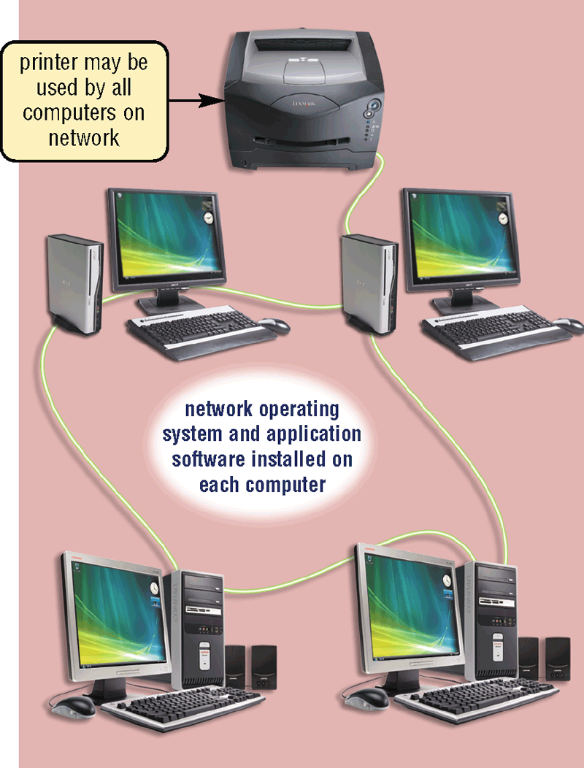
Networks
What is a peer-to-peer network?
Simple network that connects fewer than 10 computers
Each computer, or peer, has equal capabilities
p. 473 Fig. 9-14
Next

Slide 17
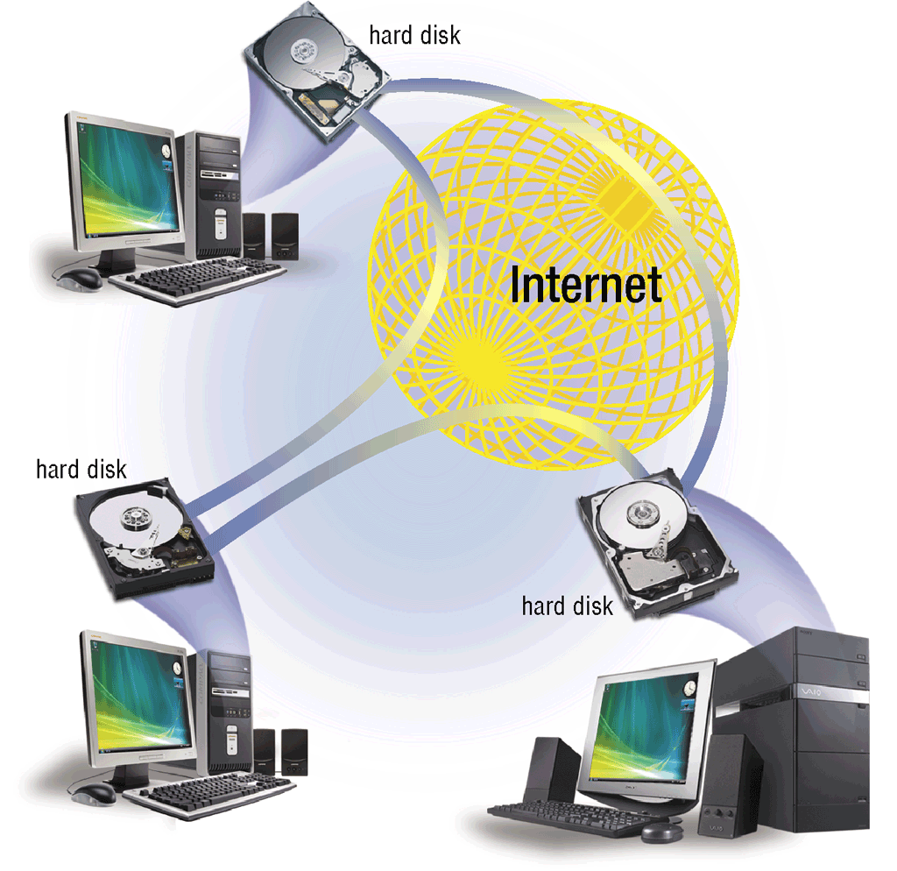
Networks
What is Internet peer-to-peer (P2P)?
Sometimes called a file sharing network
Enables users to connect to each other’s hard disks and exchange files directly
Click to view Web Link, click Chapter 9, Click Web Link from left navigation, then click BitTorrent below Chapter 9
p. 473 - 474 Fig. 9-15
Next

Slide 18
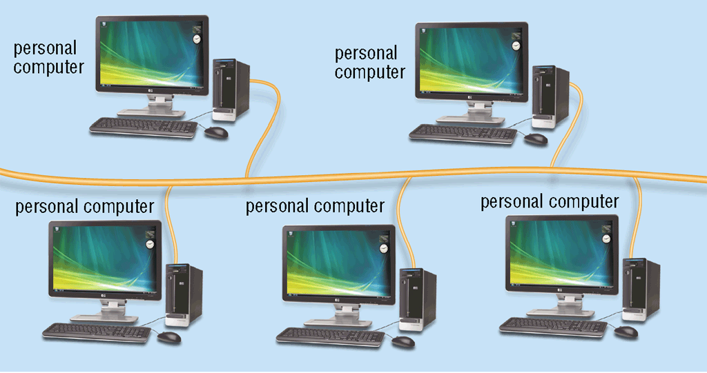
Networks
What is a bus network?
All computers and devices connect to central cable or bus
Example of network topology (layout of devices in network)
Popular topologies are bus, ring, and star
p. 474 Fig. 9-16
Next

Slide 19
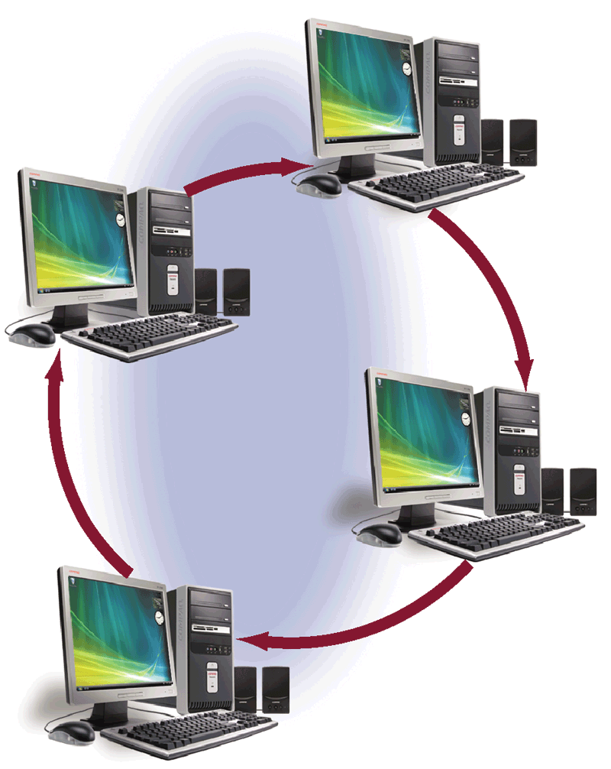
Networks
What is a ring network?
Cable forms closed loop (ring), with all computers and devices arranged along ring
Data travels from device to device around entire ring, in one direction
p. 474 Fig. 9-17
Next

Slide 20
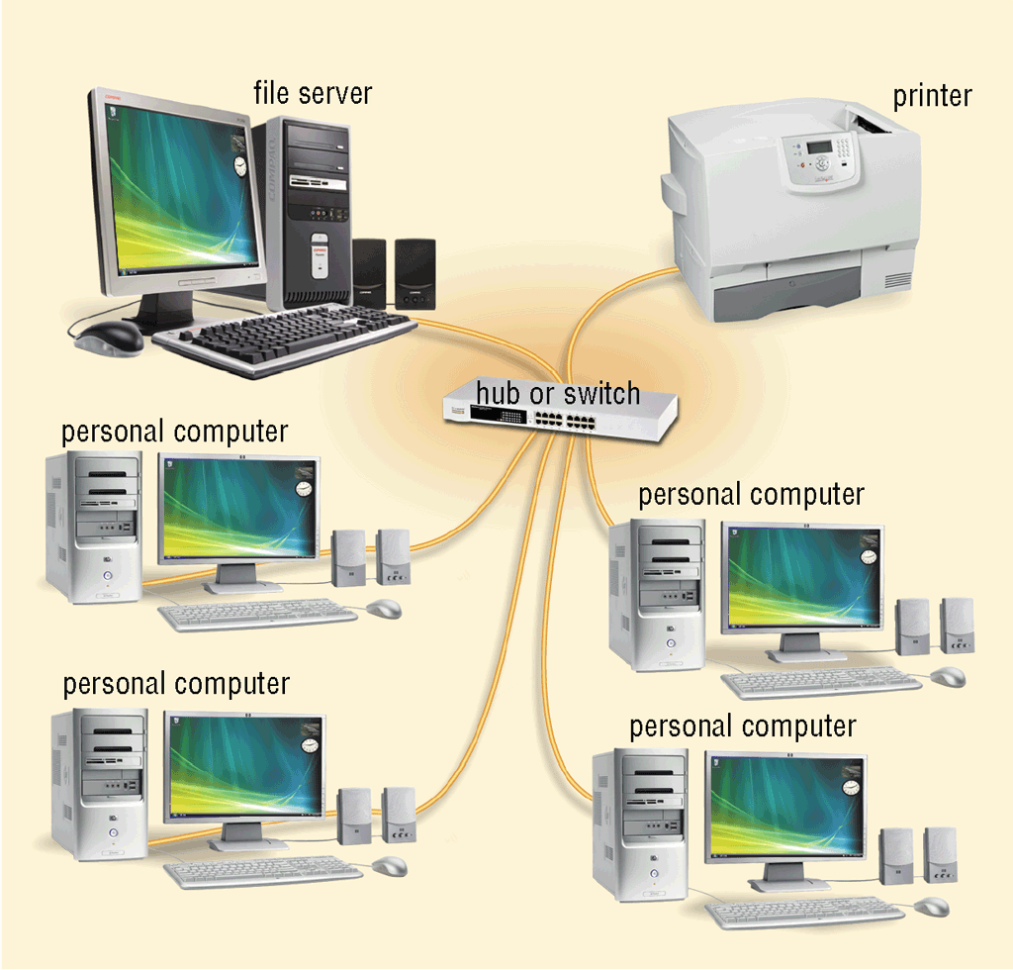
Networks
What is a star network?
All devices connect to a central device (hub or switch)
All data transferred from one computer to another passes through hub or switch
p. 475 Fig. 9-18
Next

Slide 21
Networks
What is an intranet?
Internal network that uses Internet technologies
Makes information accessible to employees
Typically includes connection to Internet
Extranet allows customers or suppliers to access part of company’s intranet
p. 475
Next

Slide 22
Network Communications Standards
What are Ethernet and token ring?
Ethernet technology allows computers to contend for access to network
If two computers send data at same time, a collision occurs and computers must send again
Token ring technology controls access to network by requiring devices to pass a special signal, called token
Click to view Web Link, click Chapter 9, Click Web Link from left navigation, then click Ethernet below Chapter 9
p. 476
Next

Slide 23
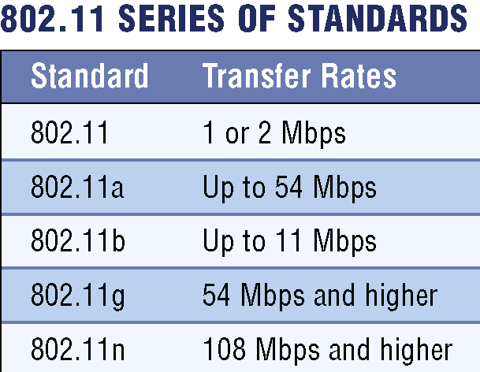
Network Communications Standards
What are TCP/IP and 802.11 (Wi-Fi)?
TCP/IP (Transmission Control Protocol/Internet Protocol) technology transmits data by breaking it up into small pieces, or packets
Commonly used for Internet transmissions
802.11 (Wi-Fi) is a family of standards for wireless LANs
p. 477 - 478 Fig. 9-20
Next

Slide 24
Network Communications Standards
What is Bluetooth?
Short-range radio waves transmit data between Bluetooth devices
p. 478
Next

Slide 25
Network Communications Standards
What are UWB, IrDA, RFID, WiMAX, and Wireless Applications Protocol (WAP)?
UWB specification allows data to be transferred wirelessly via short-range radio waves
IrDA specification allows data to be transferred wirelessly via infrared light waves
Worldwide Interoperability for Microwave Access (WiMAX or 802.16) standard that specifies how wireless devices communicate over the air in a wide area
Radio Frequency Identification (RFID) uses radio signals to communicate with a tag placed in an object
Wireless Applications Protocol (WAP) allow wireless mobile devices to access Internet
Click to view Web Link, click Chapter 9,
Click Web Link from left navigation, then click WiMAX below Chapter 9
p. 478 - 480
Next

Slide 26
Communications Software
What is communications software?
Programs that help users establish connection to Internet, other network, or another computer
Programs that help users manage transmission of data, instructions, and information
Programs that provide an interface for users to communicate with one another
p. 480
Next

Slide 27
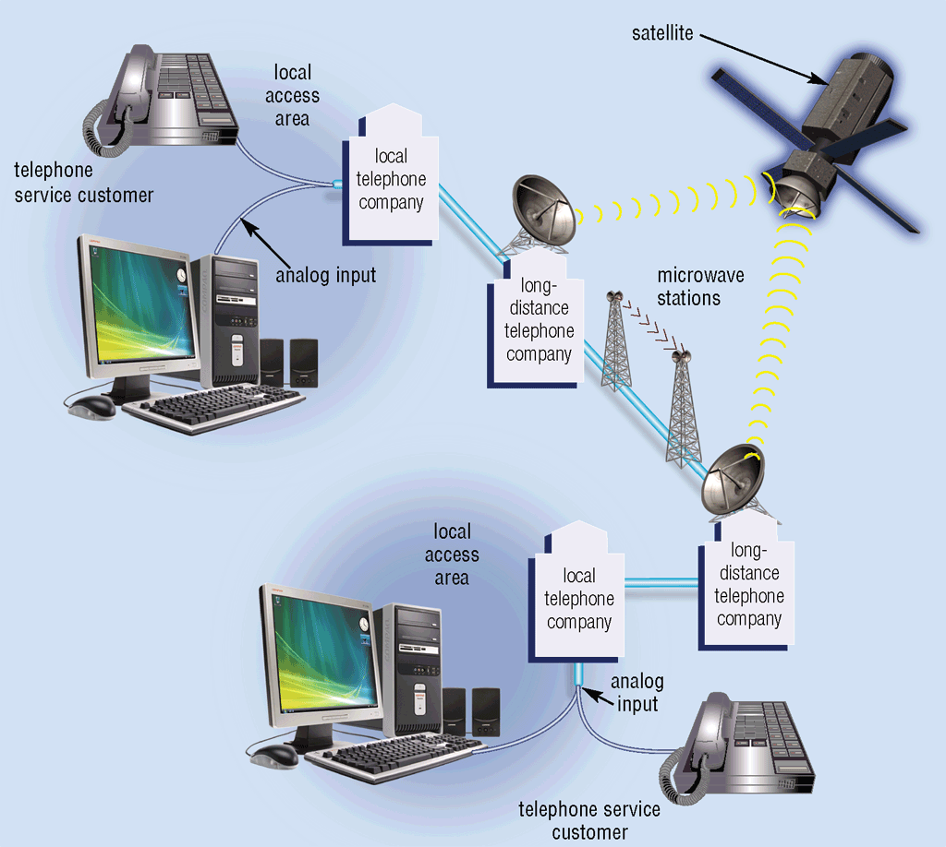
Communications Over the Telephone Network
What is the public switched telephone network (PSTN)?
Worldwide telephone system that handles voice-oriented telephone calls
p. 481 Fig. 9-23
Next

Slide 28
Communications Over the Telephone Network
What is a dial-up line?
Temporary connection using telephone line for communications
Costs no more than making regular call
Computers at any two locations can establish a connection using modems and telephone network
p. 481
Next

Slide 29
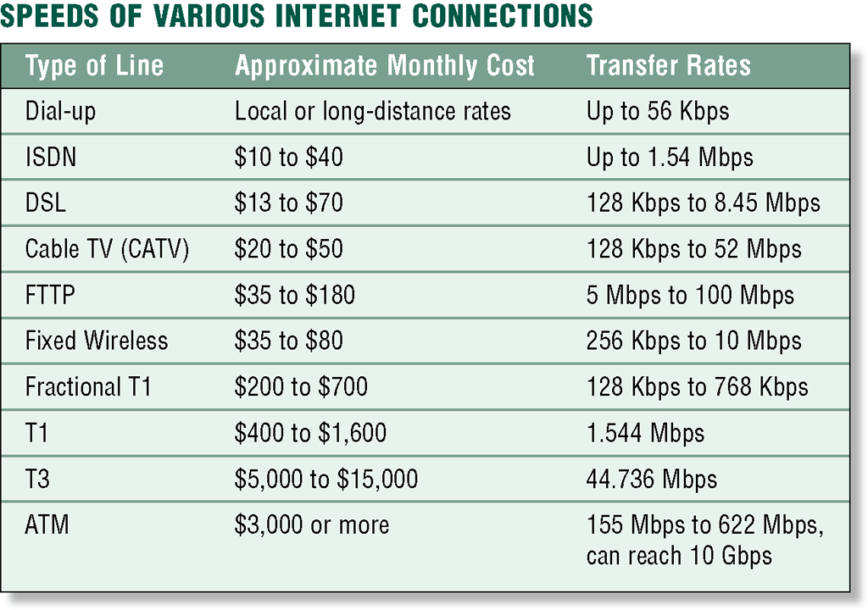
Communications Over the Telephone Network
What is a dedicated line?
Always-on connection between two communications devices
Five types are ISDN line, DSL, FTTP, T-carrier line, and ATM
Click to view Web Link, click Chapter 9, Click Web Link from left navigation, then click FTTH below Chapter 9
p. 482 Fig. 9-24
Next

Slide 30
Communications Devices
What are examples of communications devices?
Common types are dial-up modems, ISDN and DSL modems, cable modems, wireless modems, network cards, wireless access points, routers, and hubs
ISDN and DSL modems send and receive data from ISDN and DSL lines
p. 484
Next

Slide 31
Communications Devices
What is a dial-up modem?
A dial-up modem converts digital signals to analog signals and vice versa
Usually in the form of an adapter card
p. 485
Next

Slide 32
Communications Devices
What are ISDN and DSL modems?
Communications devices that send and receive digital ISDN and DSL signals
Usually external devices in which one end connects to a telephone line and the other end connects to a port on the system unit
p. 485
Next

Slide 33
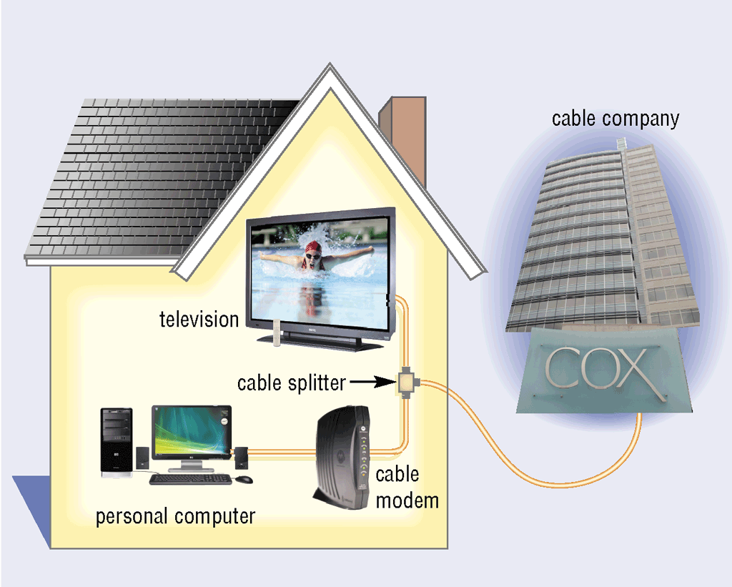
Communications Devices
What is a cable modem?
Sends and receives data over cable television network
Much faster than dial-up modem or ISDN
Sometimes called a broadband modem
Click to view Web Link, click Chapter 9, Click Web Link from left navigation, then click Cable Modems below Chapter 9
p. 484 - 486 Fig. 9-28
Next

Slide 34
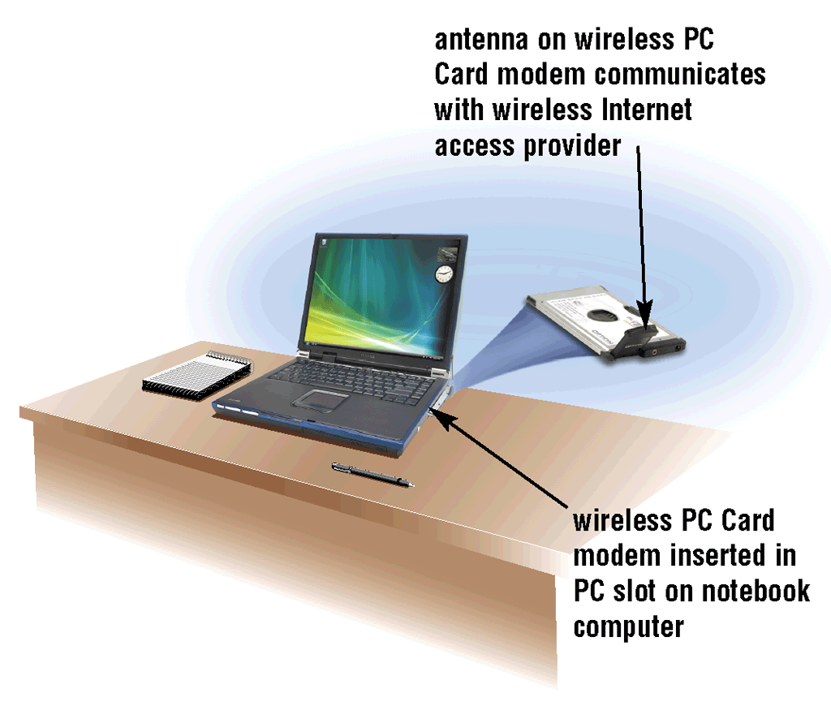
Communications Devices
What is a wireless modem?
Allows access to the Web wirelessly from a notebook computer, a smart phone, or other mobile device
Typically use the same waves used by cellular telephones
p. 486 Fig. 9-29
Next

Slide 35
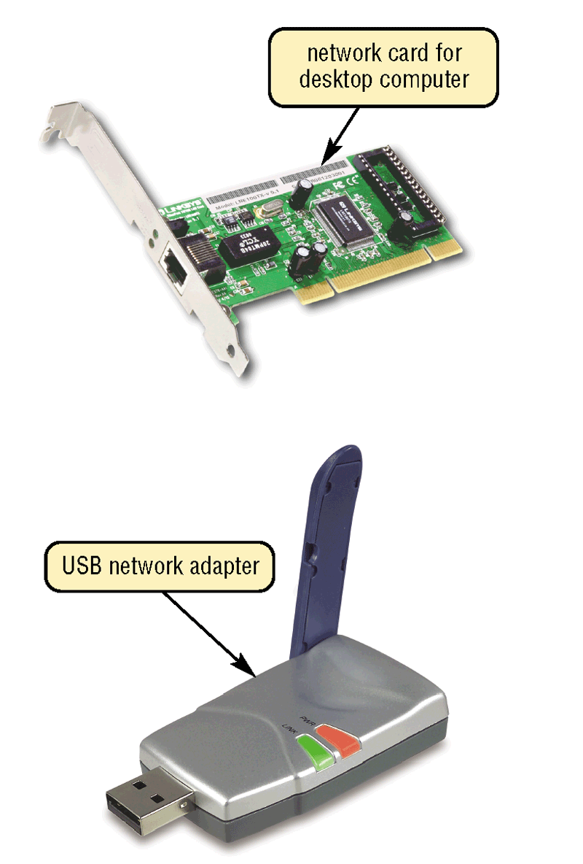
Communications Devices
What is a network card?
Adapter card, PC Card, ExpressCard module, USB network adapter, or flash card that enables computer or device to access network
Sometimes called network interface card (NIC)
p. 486 - 487 Fig. 9-30
Next

Slide 36
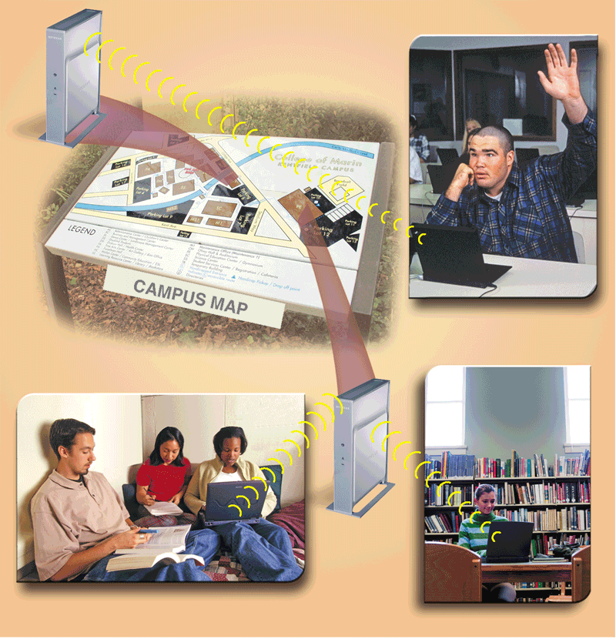
Communications Devices
What is a wireless access point?
Central communications device that allows computers and devices to transfer data wirelessly among themselves or wirelessly to a wired network
p. 487 Fig. 9-31
Next

Slide 37
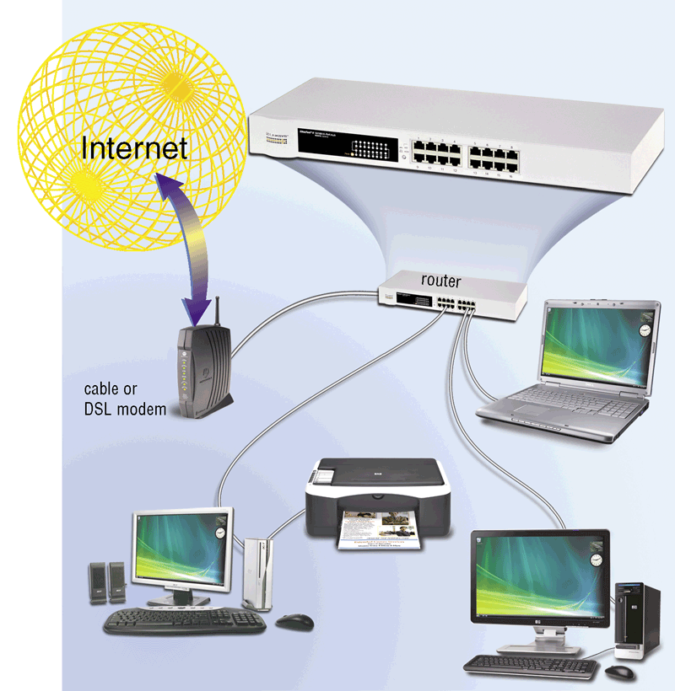
Communications Devices
What is a router?
Connects computers and transmits data to correct destination on network
Routers forward data on Internet using fastest available path
Some routers have a built-in hardware firewall
Click to view Web Link, click Chapter 9, Click Web Link from left navigation, then click Wireless Routers below Chapter 9
p. 488 Fig. 9-32
Next

Slide 38
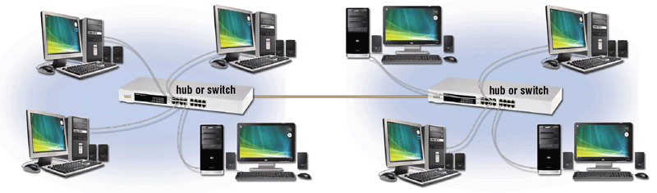
Communications Devices
What is a hub or switch?
Device that provides central point for cables in network
p. 488 - 489 Fig. 9-33
Next

Slide 39
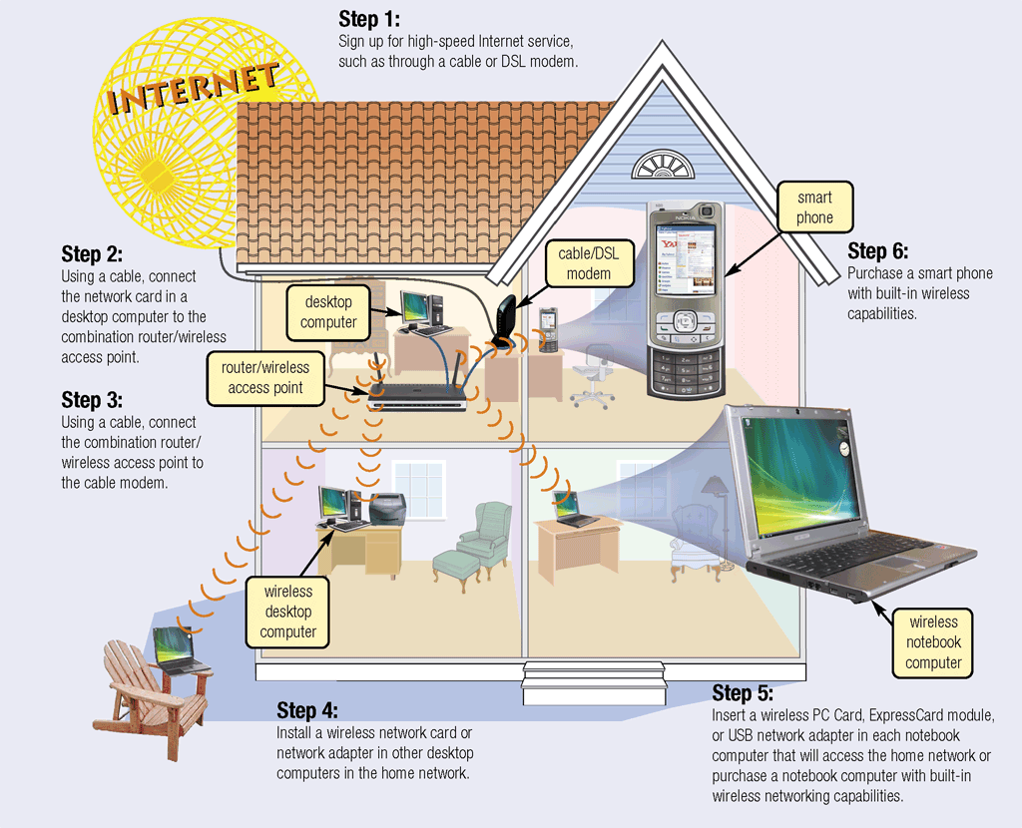
Home Networks
What is a home network?
Multiple computers connected in home
Several types of home networks
Ethernet — connect computers via cable
Powerline cable — use electrical lines in house
Phoneline — use telephone lines
Click to view Web Link, click Chapter 9, Click Web Link from left navigation, then click Home Networks below Chapter 9
p. 489 - 490 Fig. 9-34
Next

Slide 40
Communications Channel
What is a communications channel?
Transmission media on which data travels in communications system
Transmission media are materials or substances capable of carrying one or more signals
Bandwidth is amount of data that can travel over a communications channel
p. 491
Next

Slide 41
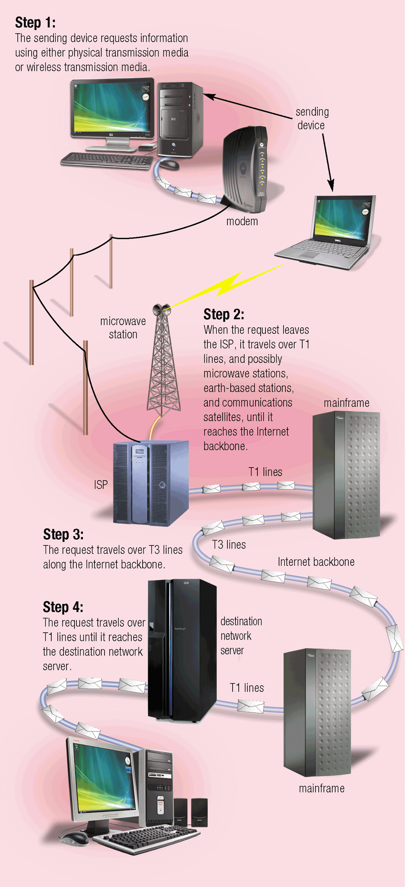
Communications Channel
How is a request sent over the Internet using a communications channel?
p. 491 Fig. 9-35
Next

Slide 42
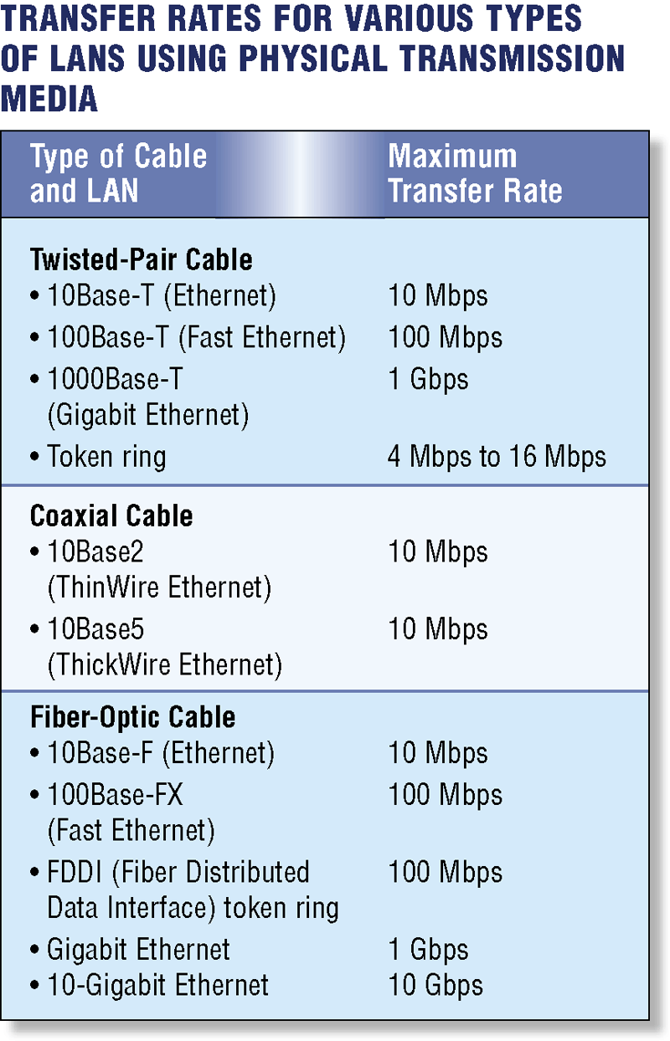
Physical Transmission Media
What is physical transmission media?
Wire, cable, and other tangible materials used to send communications signals
p. 492 Fig. 9-36
Next

Slide 43
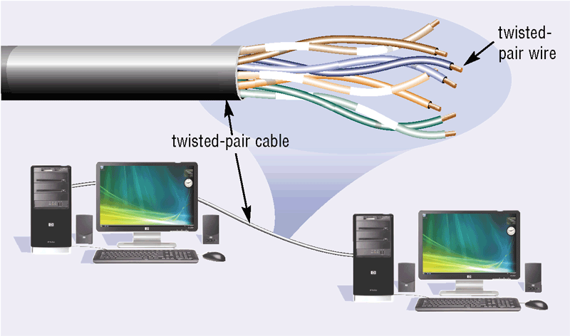
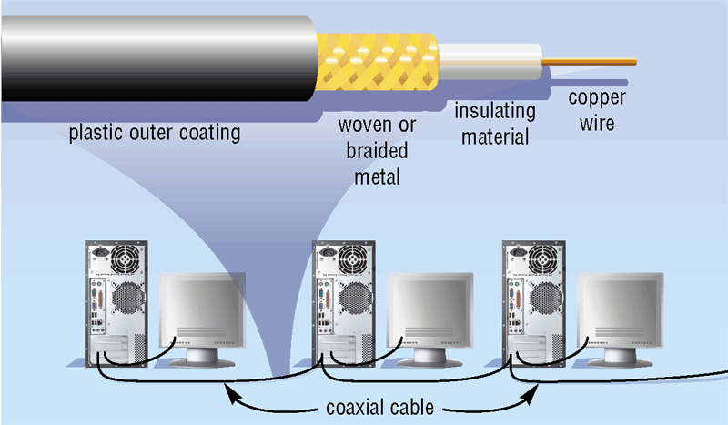
Physical Transmission Media
What are twisted-pair cable and coaxial cable?
Twisted-pair cable is used for telephone systems and network cabling
Coaxial cable is often used for cable television wiring
p. 493 Fig. 9-37—9-38
Next

Slide 44
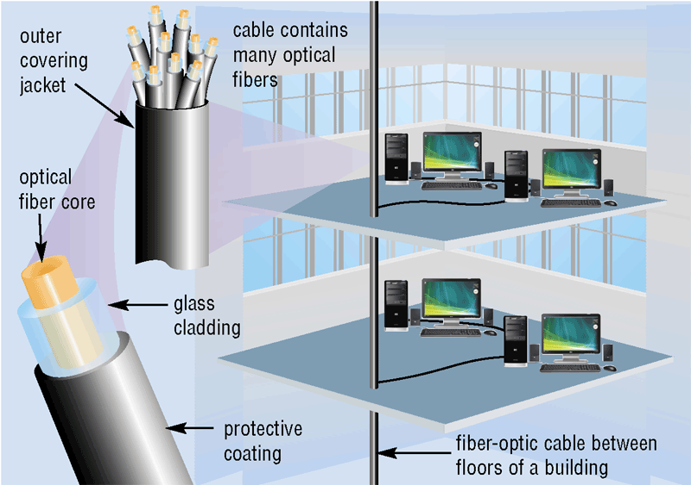
Physical Transmission Media
What is fiber-optic cable?
Capable of carrying significantly more data at faster speeds than wire cables
Less susceptible to interference (noise) and, therefore, more secure
Smaller size (thinner and lighter)
p. 493 Fig. 9-39
Next

Slide 45
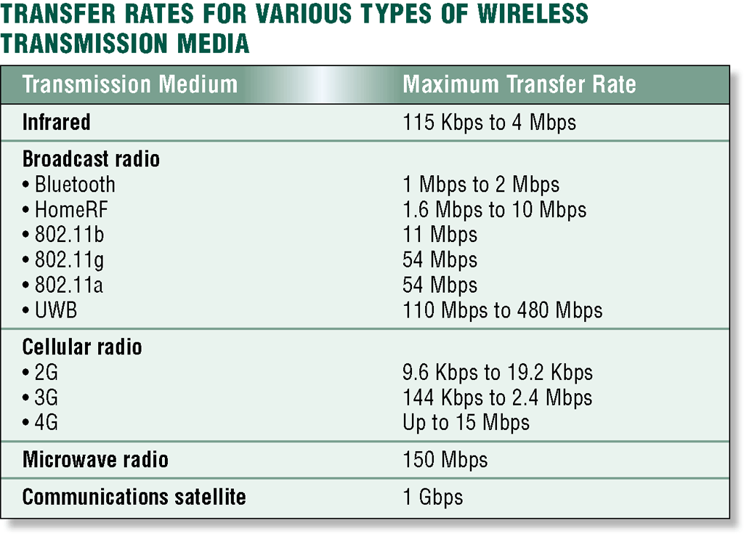
Wireless Transmission Media
What is wireless transmission media?
Used when inconvenient, impractical, or impossible to install cables
Includes Bluetooth and IrDA
p. 494 Fig. 9-40
Next

Slide 46
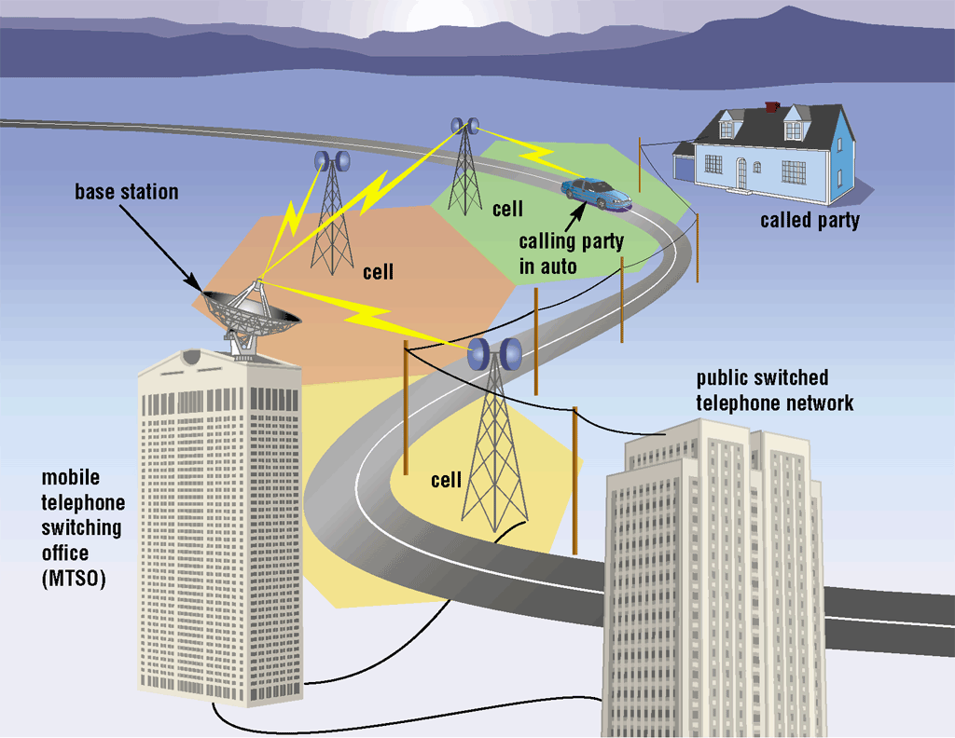
Wireless Transmission Media
What are broadcast radio and cellular radio?
Broadcast radio distributes radio signals over long and short distances
Cellular radio is form of broadcast radio used for mobile communications
Click to view Web Link, click Chapter 9, Click Web Link from left navigation, then click 4G Networks below Chapter 9
p. 494 and 495 Fig. 9-41
Next

Slide 47
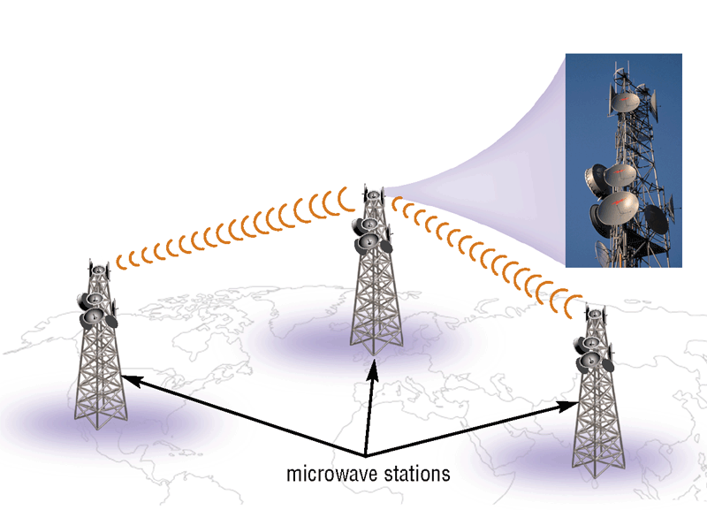
Wireless Transmission Media
What is a microwave station?
Earth-based reflective dish used for microwave communications
Must transmit in straight line with no obstructions
p. 496 Fig. 9-42
Next

Slide 48
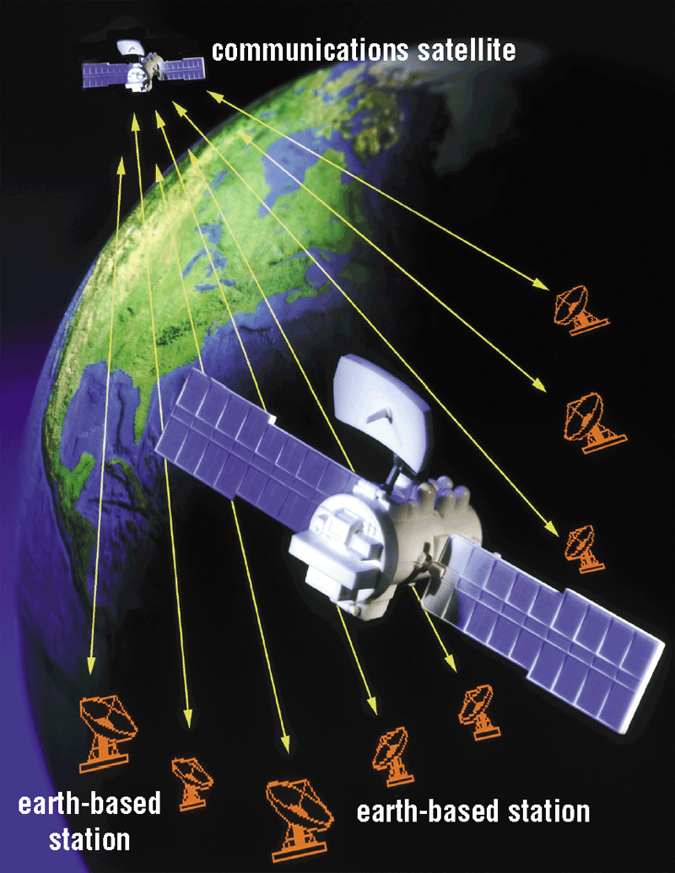
Wireless Transmission Media
What is a communications satellite?
Space station that receives microwave signals from earth-based station, amplifies signals, and broadcasts signals back to any number of earth-based stations
p. 496 Fig. 9-43
Next

Slide 49
Summary of Communications and Networks
Communications terminology and applications
Various communications devices, media, and procedures
How to join computers into a network
Chapter 9 Complete

